Slide 1


Cryptocurrency
Bitcoin & Cryptocurrency Technology

Slide 2
Roadmap
Cryptography
Identities
Blockchain
Bitcoin & Mining
Altcoins

Slide 3


Slide 4
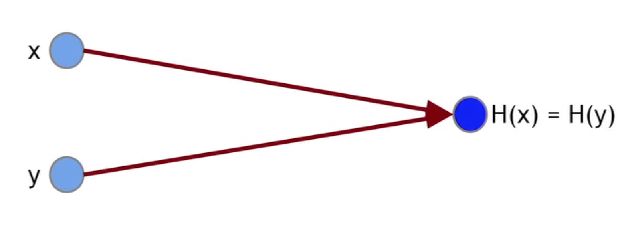
Cryptography
Hash function H(x) = y
Collision-Free
Puzzle
H(puzzleId | x) = hash

Slide 5
Identities Addresses
Signatures - API
generateKeys(size)
pk: publicKey
sk: secretKey
sign(sk, hash(msg))
verify(pk, hash(msg), sig)

Slide 6
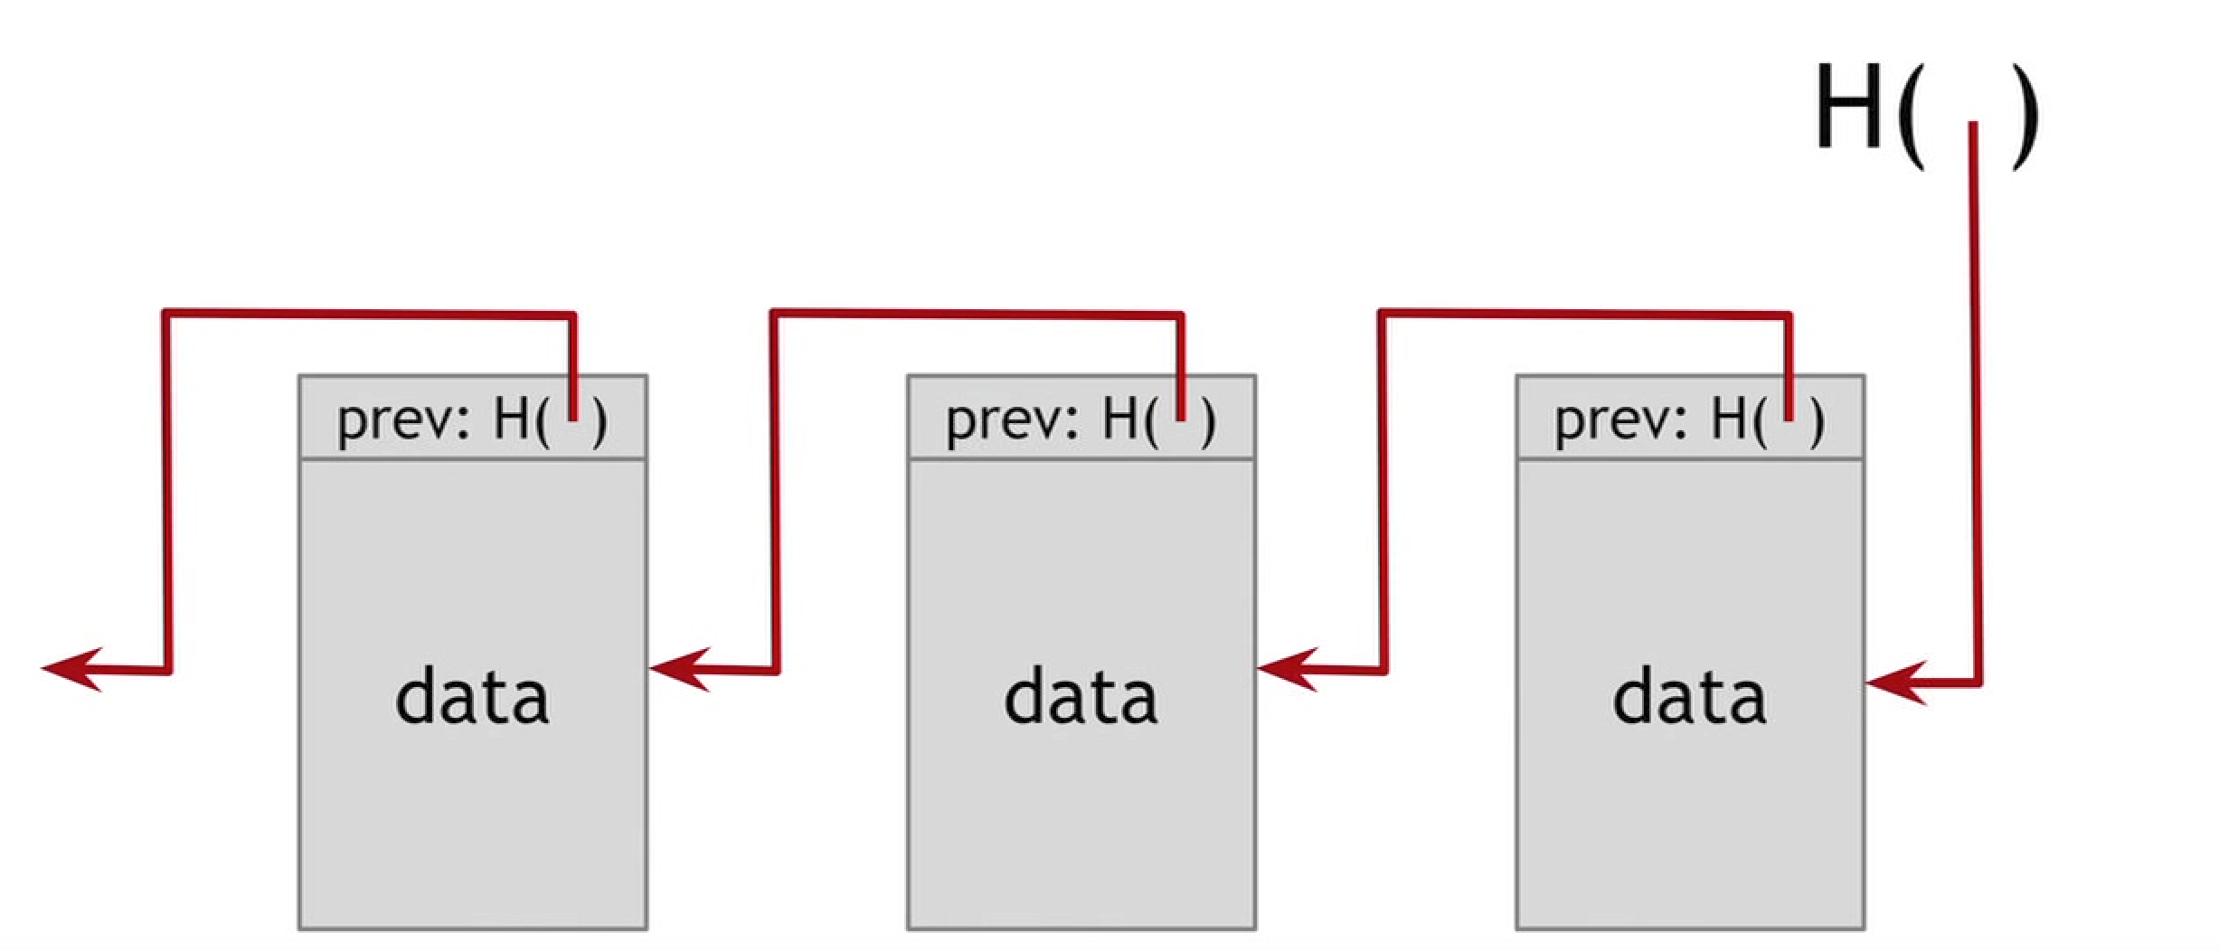
Blockchain
Hash pointer structure
Data cannot be changed
Append only ledger

Slide 7
Bitcoin Block PoW
Header
Hash previous block
Hash this block
Difficult target (nonce)
Transaction list
Signatures

Slide 8
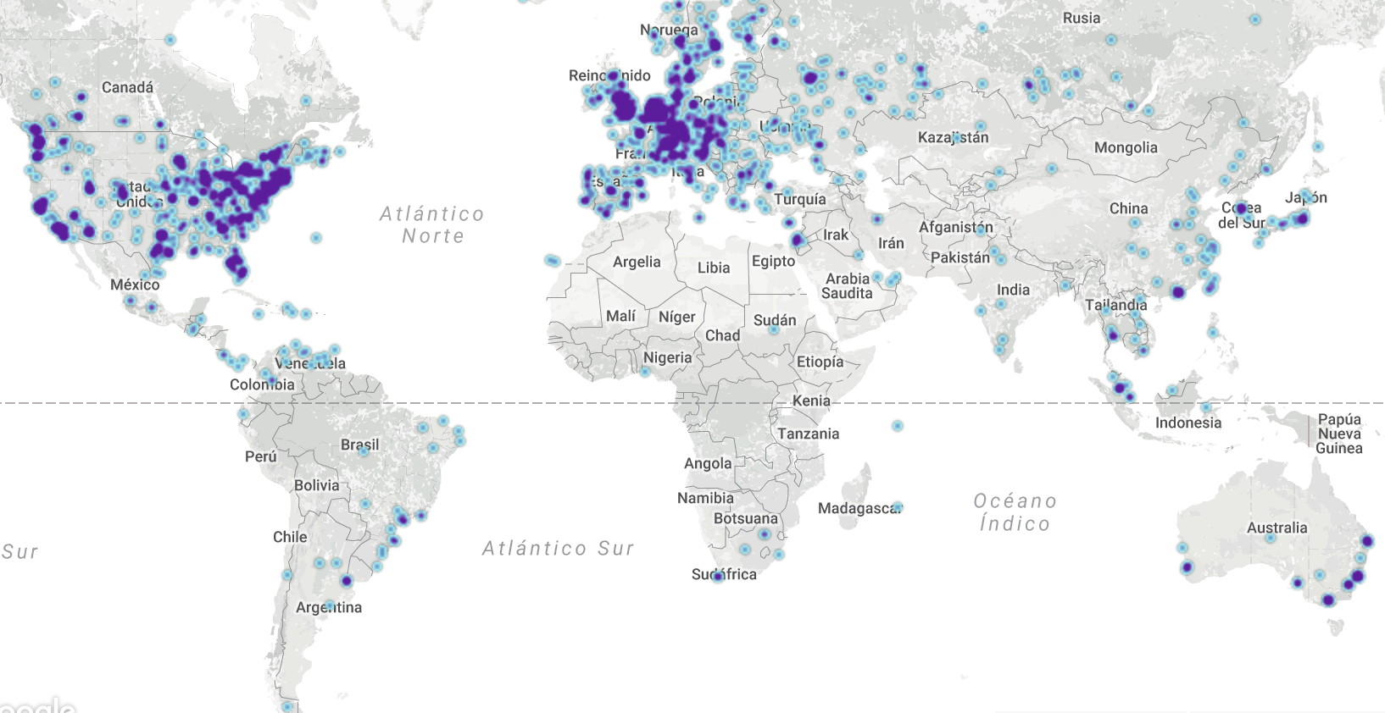
Bitcoin Decentralization
Identities
Nodes
Consensus Protocol
Peer-to-peer

Slide 9
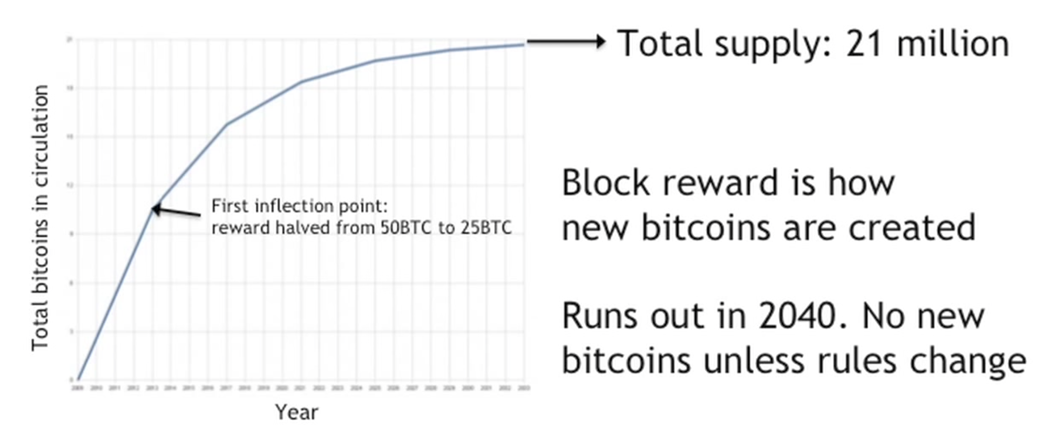
Bitcoin

Slide 10
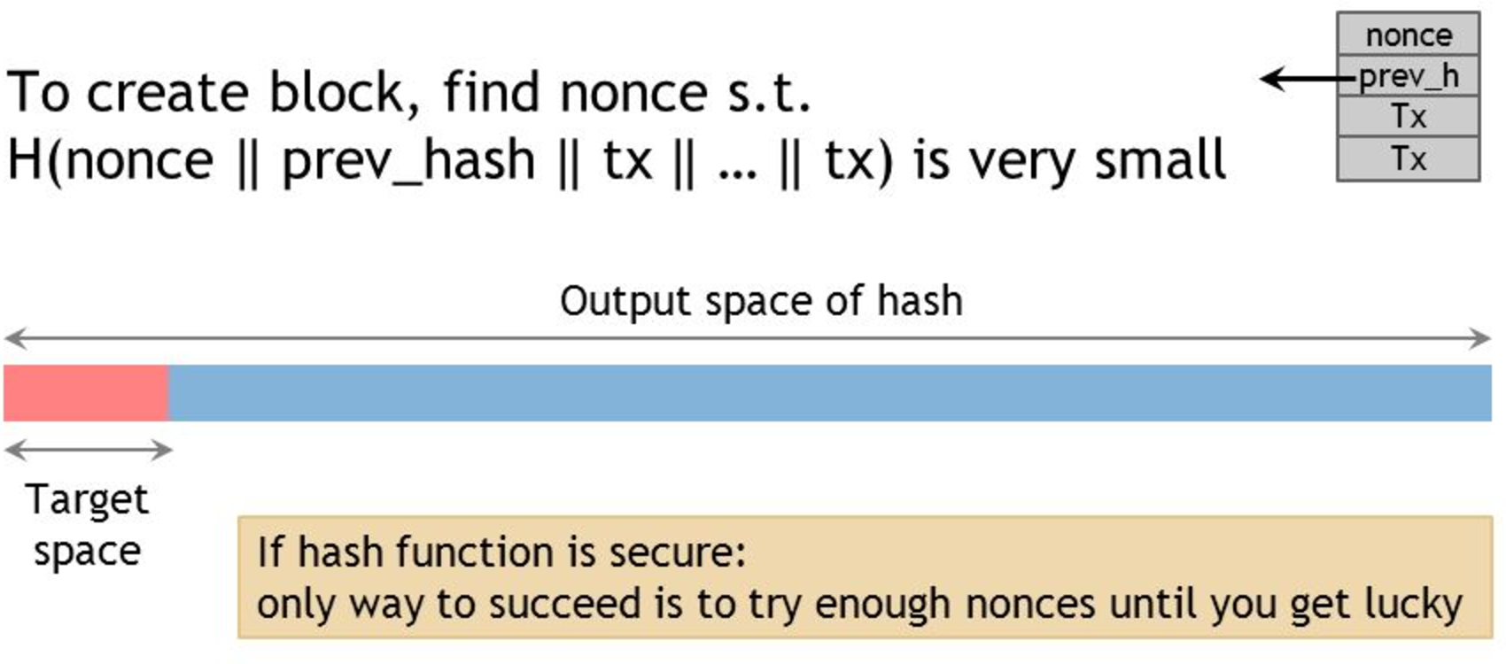
Hash Puzzle PoW

Slide 11
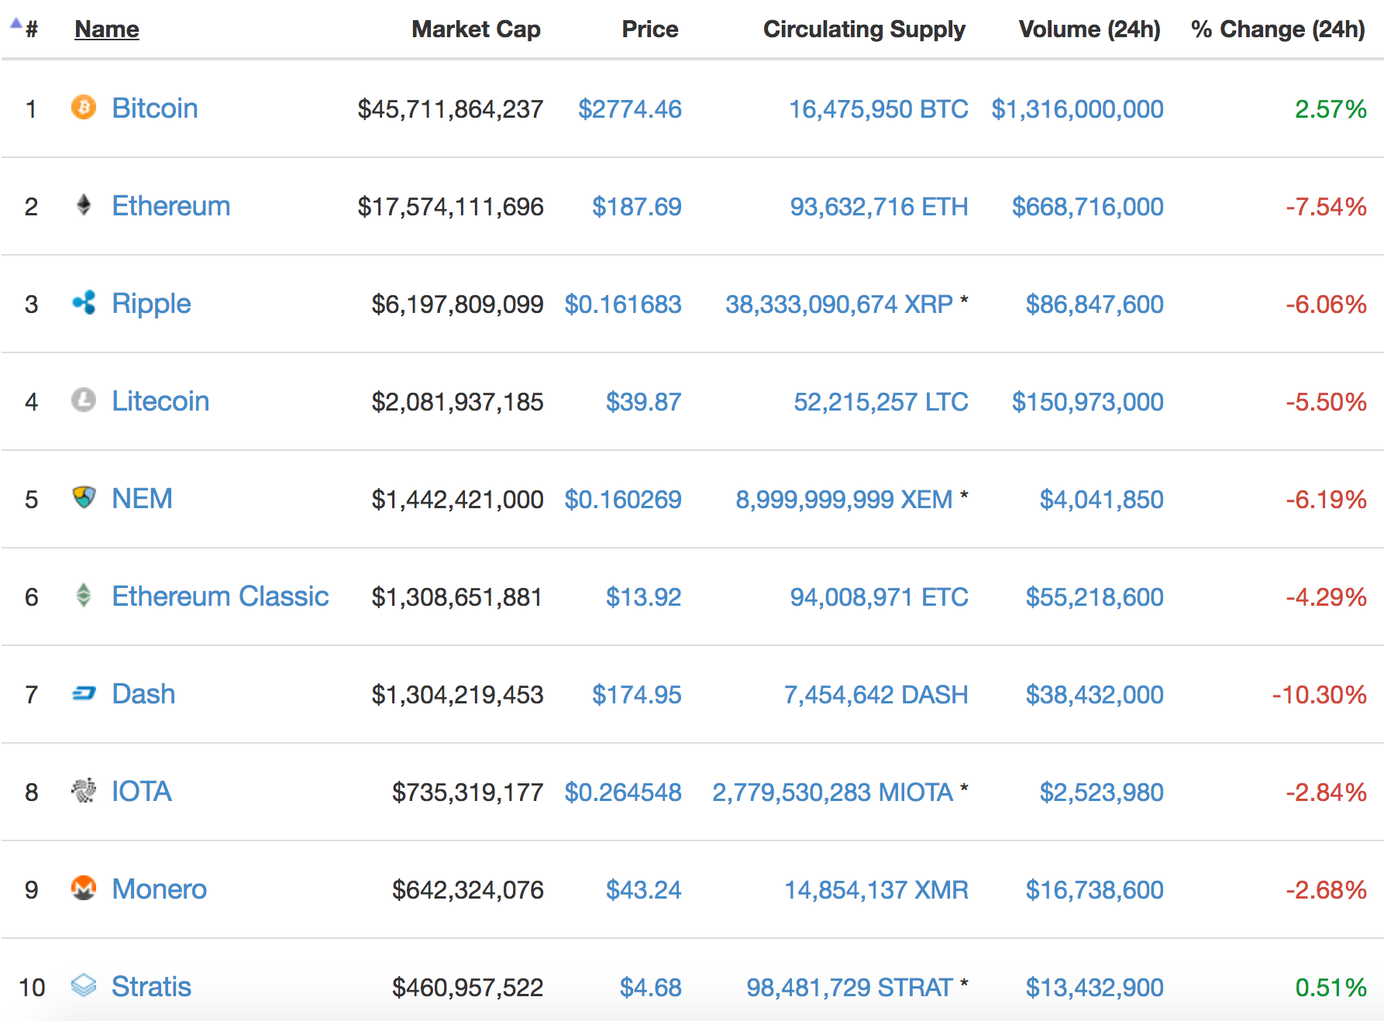
Altcoins Market

Slide 12
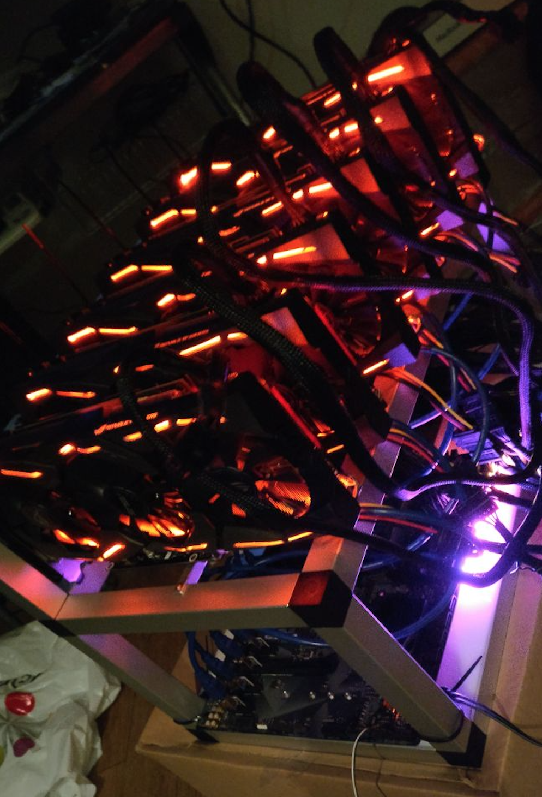
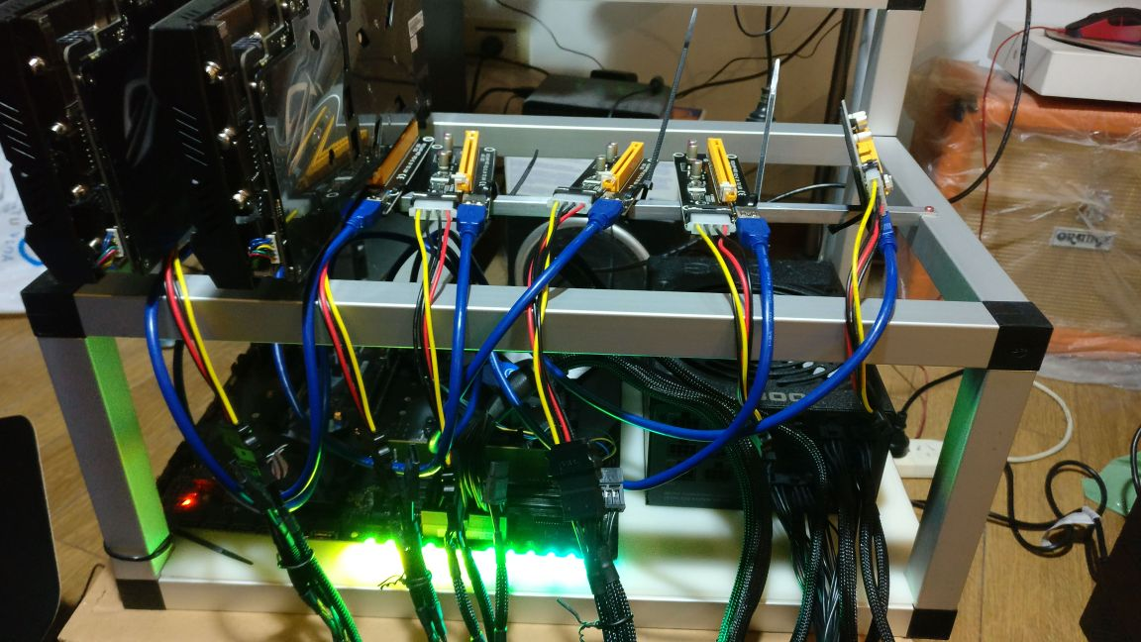
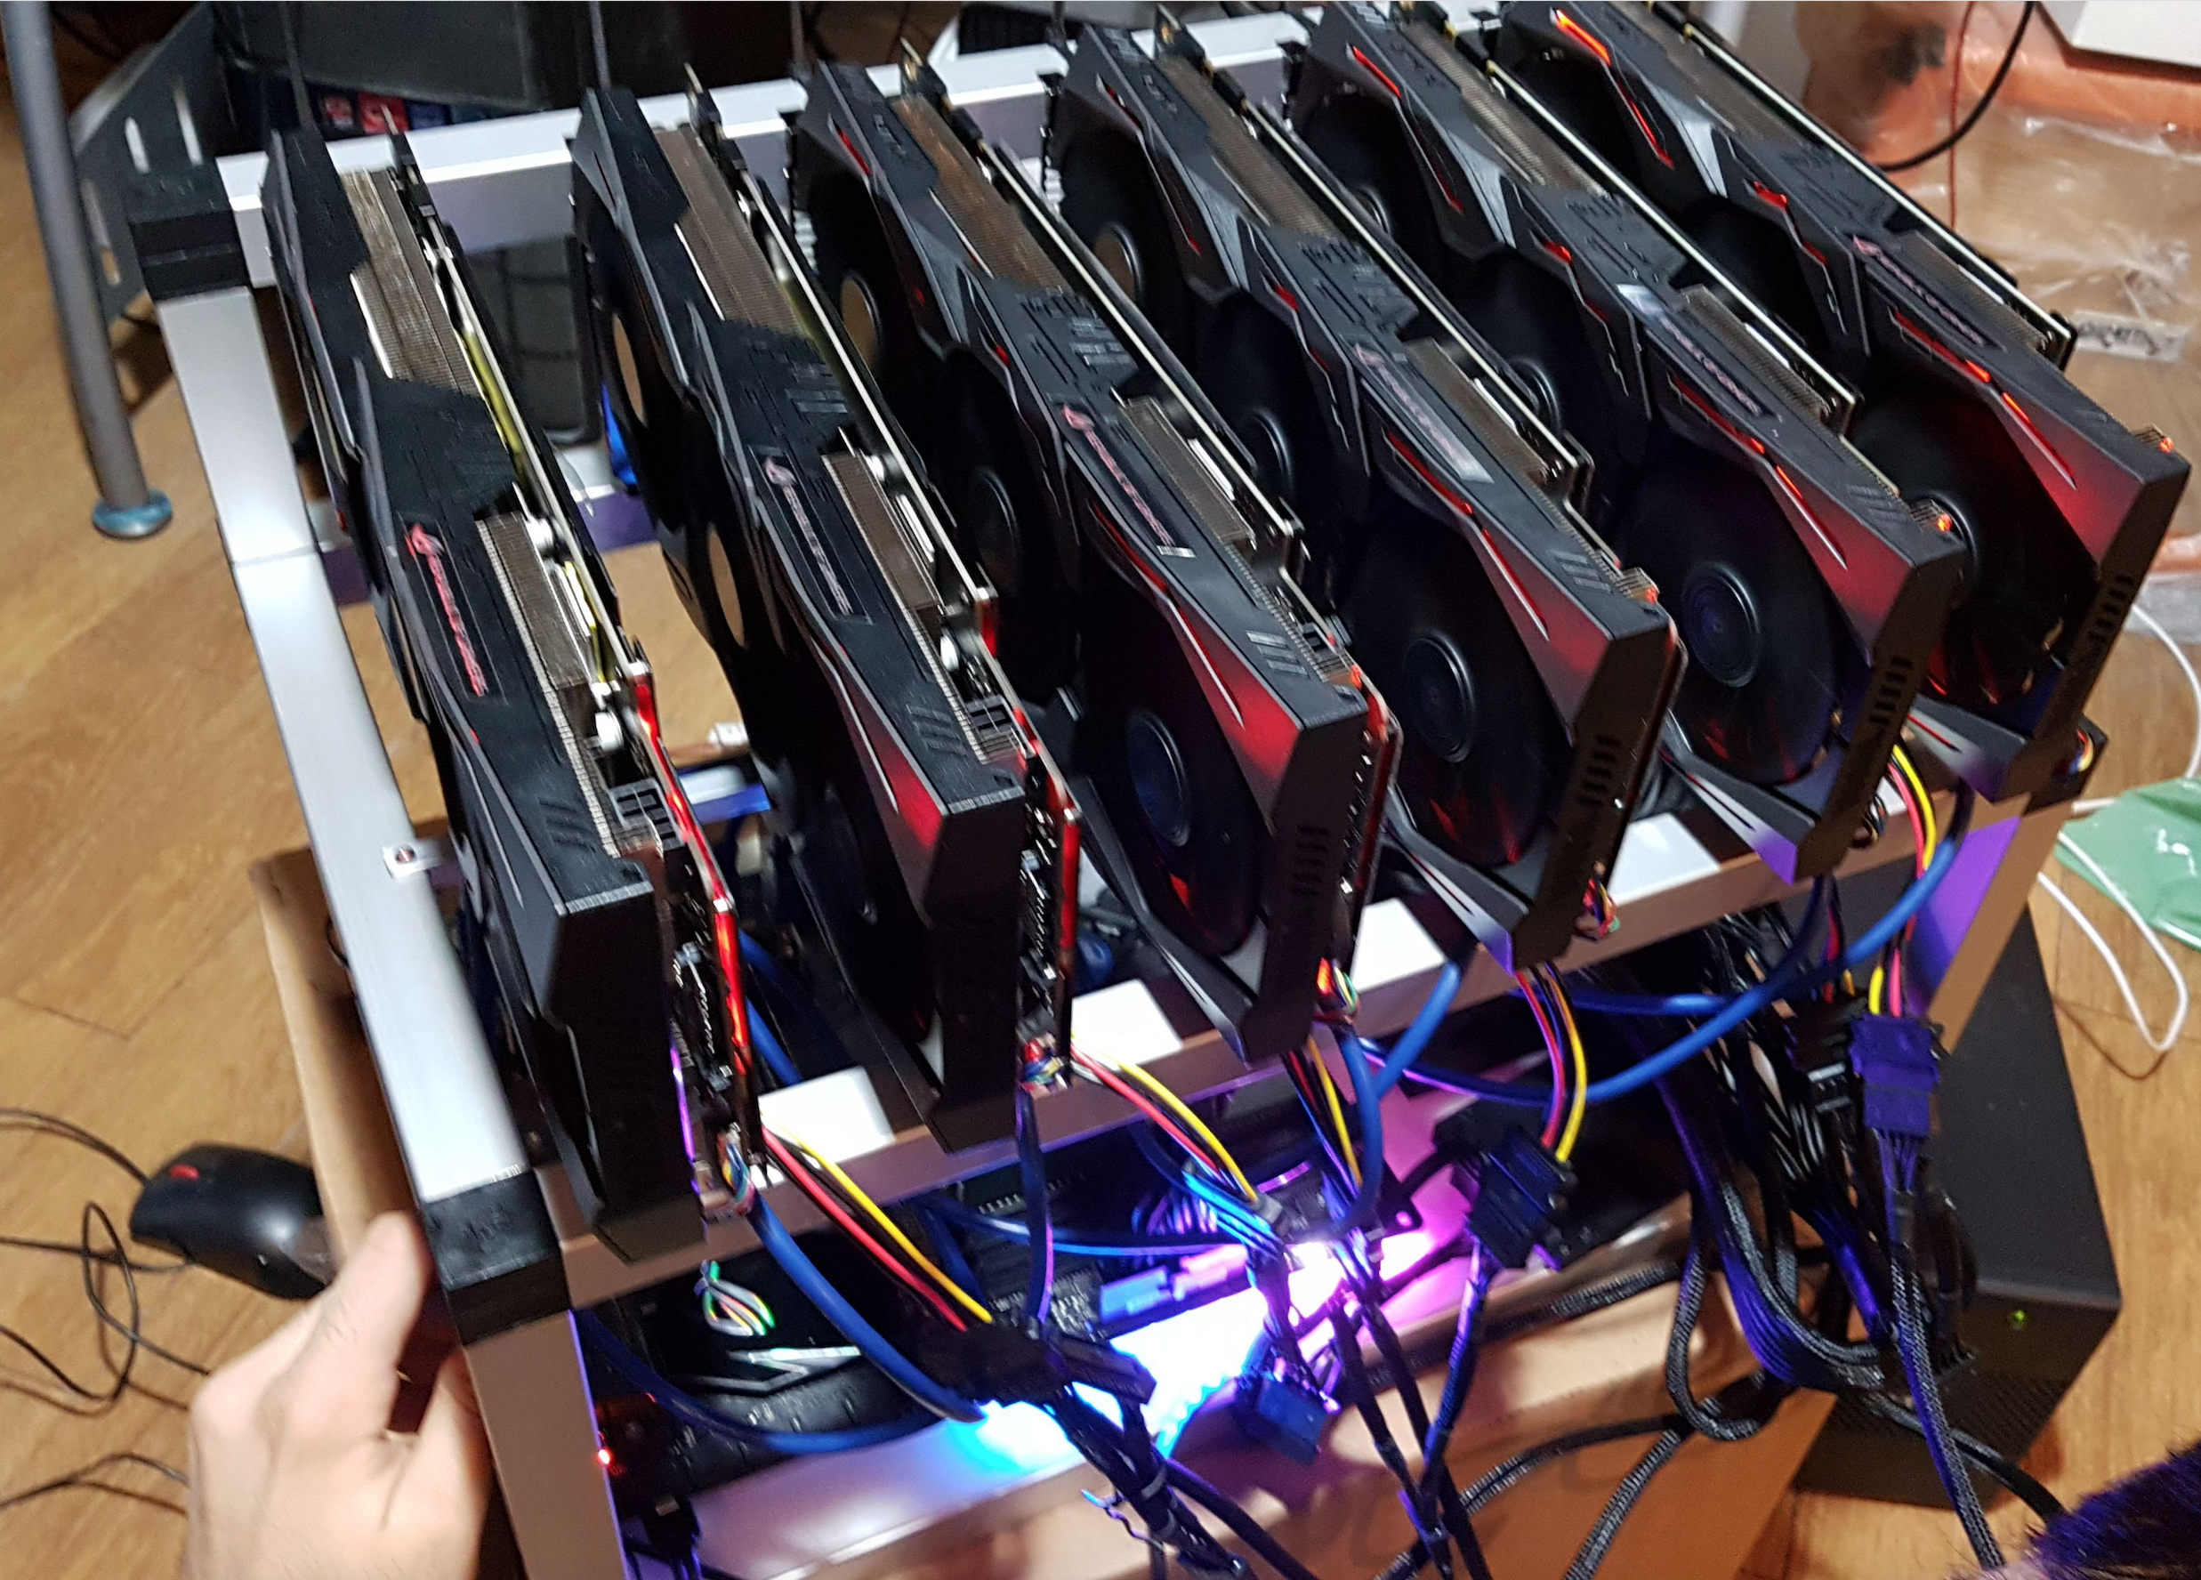
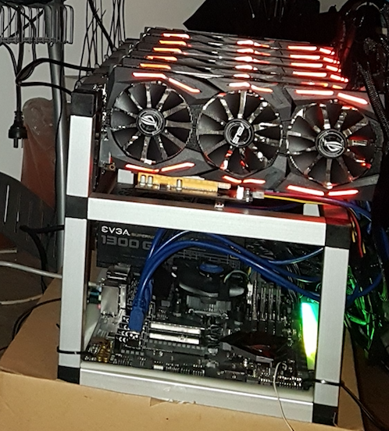

Slide 13
Questions?

Slide 14
Thanks!

